Slide 1

International Union for the Scientific Study of Population IUSSP

Slide 2
IUSSP: the worldwide network of population scientists
The IUSSP mission is to promote the scientific study of population, encourage exchange between researchers around the globe, and stimulate interest in population issues.
The IUSSP is a community with active policies in place to boost and acknowledge the inputs of early career colleagues
Young colleagues are welcome!

Slide 3
WHY JOIN IUSSP IN THE BEGINNING OF YOUR CAREER?
Connect with the global population research community
Broaden your horizon, cross (disciplinary and other) borders and extend your network
Sample the richness of our discipline through a variety of activities
Some 20 Scientific Panels, including an Early Career Perspectives Panel
Organizing webinars, workshops, training sessions
Stay up-to-date: IUSSP Bulletin, N-IUSSP our online Newsmagazine, IUSSP Website

Slide 4
More reasons to join?
IUSSP is a member-driven organization: being a member has an impact
All activities are organized by and for members. And there is more …
International Population Conference 2025, Brisbane, Australia. The Olympics of Demography!
Reduced IPC conference fee for student members. And more ….
Free student membership for up to 4 years
AS A MEMBER YOU CAN ENGAGE IN OUR WORK AND HELP STRENGTHEN OUR DISCIPLINE

Slide 5
IUSSP Early Career Perspectives Panel
The objective of this Panel is to boost the inputs of early career colleagues in the activities of the IUSSP. By actively engaging and directly involving young colleagues in our work, the Panel works towards making the IUSSP more visible and attractive to new generations of population experts.
The work program of the Panel is defined by the group. Like its predecessor the Early Career Taskforce (2019-2022), the Panel also organizes activities of special interest to younger colleagues (e.g. training, networking).

Slide 6
IUSSP EARLY CAREER PERSPECTIVES PANEL
José Manuel Aburto (University of Oxford)
Mayanka Ambade (Harvard University)
Donatus Yaw Atiglo (University of Ghana)
Marie-Pier Bergeron Boucher (University of Southern Denmark)
Michelle Eilers (University of Texas at Austin)
Qing Guan (Australian National University)
Olutoyin Ikuteyijo (Universität Basel)
Moana Rarere (University of Waikato)
Ankit Sikarwar (French Institute for Population Studies (INED))
Samuel A. G. Silva (Demography Department, Cedeplar, UFMG)
Sergi Trias-Llimós (Center for Demographic Studies)
Council Liaison
Ann Moore (Guttmacher Institute)
Nico Van Nimwegen (Netherlands Interdisciplinary Demographic Institute NIDI)

Slide 7
IUSSP EARLY CAREER AWARDS
Established in 2023. Deadline for submissions 1 June 2023!
Acknowledge and honor outstanding contributions to the development of our discipline and the broad field of population studies by early career scholars in the various regions in the world and boost the global visibility of their achievements.
Established for: Africa; Asia and the Pacific; Europe; Latin America and the Caribbean; North America. One Award per region.
In a unique collaboration with Union for African Population Studies (UAPS), Asian Population Association (APA), European Association for Population Studies (EAPS), Latin American Population Association (ALAP), and Population Association of America (PAA).

Slide 8
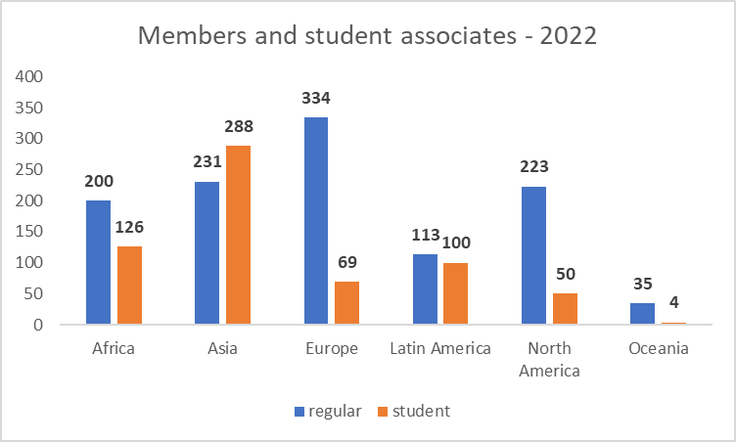
Membership

Slide 9
so why don’t you join? https://iussp.org

